Slide 1
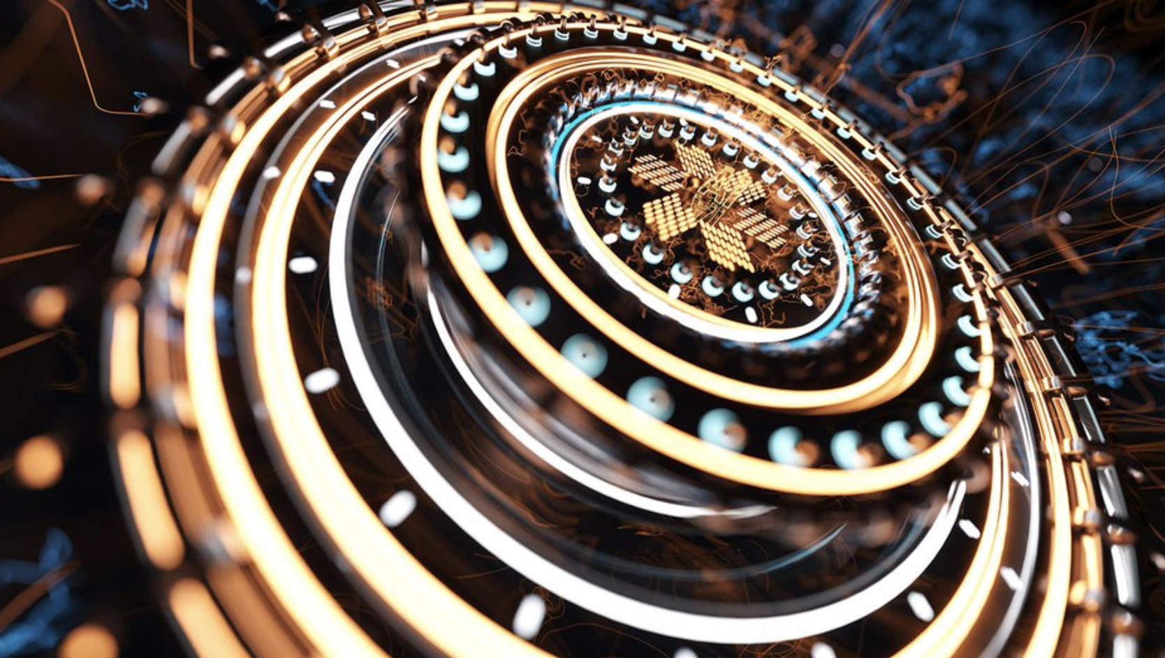
Quantum Computing
Group Members: Ahmed Sheik, Abdulmajeed Mohamed, Solomon Ayele, Abdihakem Bashe

Slide 2
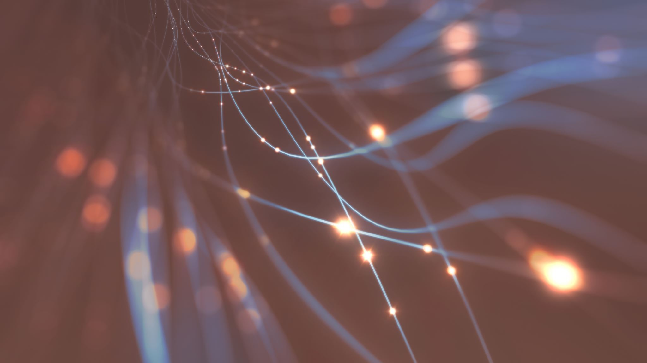
What is Quantum Computing? …..

Slide 3
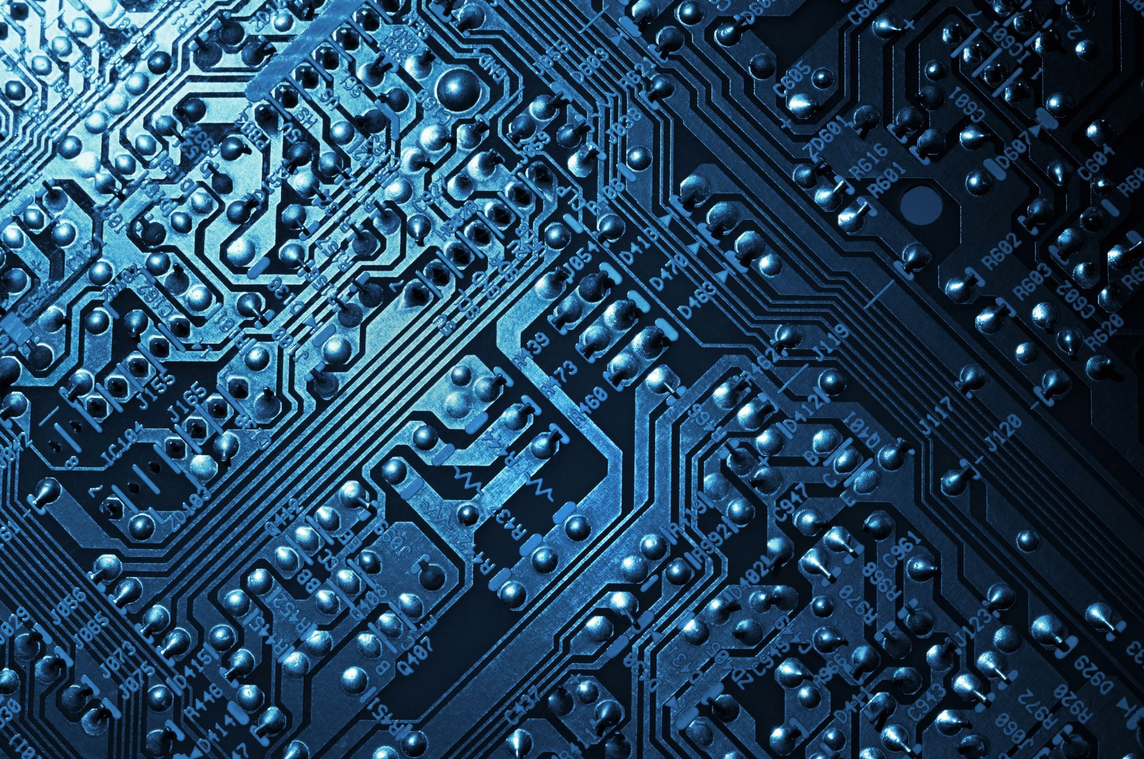
Continued. What is Quantum Computing?
Quantum Computing is a fast-developing field of computing , it can. address issues that are too difficult for conventional computers..
Quantum computing makes use of the specialized hardware to take advantage of the characteristics.
Quantum computing executes some operations faster than any current classical computer.
Quantum computing only accepts a small number of inputs, runs an algorithm, and then outputs the result.
Quantum bits, are the foundation of quantum computing and can store both zeros and ones.
Quantum computers don't provide a single, definitive answer; instead, they provide a variety of potential solutions.

Slide 4
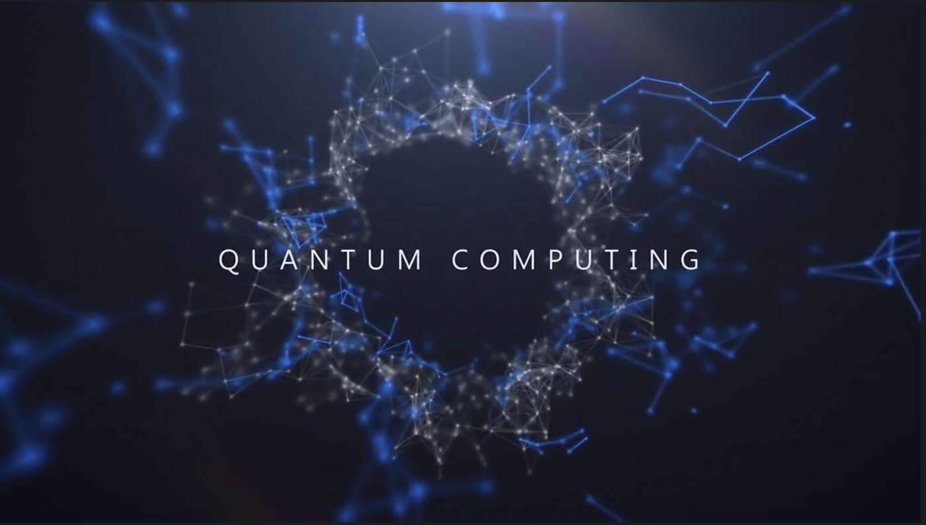
Introduction
Quantum Computing is used for a variety of different aspects within daily life some examples include.
Computer Security
Biomedicine
Mobility and Transport services
Healthcare
Finance

Slide 5
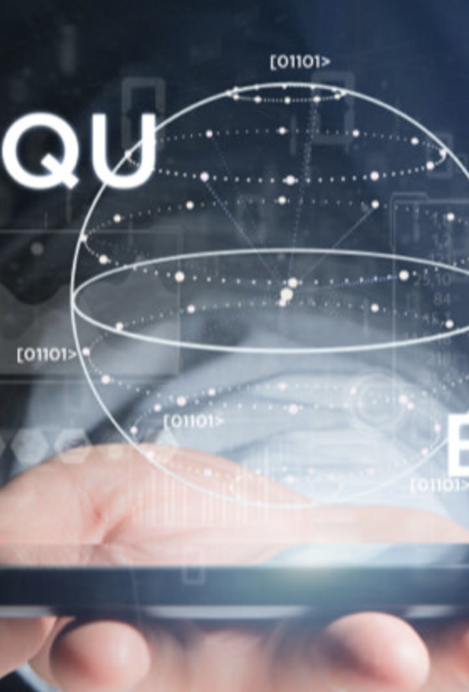
Key Points of Quantum Computing
The system's output calculations are based on quantum mechanics.
The tiniest discrete unit of any physical attribute is called a quantum.
Includes characteristics of atomic or subatomic particles such as photons, neutrinos, and electrons.
Although they function similarly to bits in classical computing, qubits exhibit completely distinct behavior.
Qubits may store a superposition of all conceivable states, unlike conventional bits, which can only keep a position of 0 or 1.

Slide 6

Quantum Hardware Structure
One of the top methods for quantum computing is using superconducting circuits. Using minuscule loops of a superconducting material that can transmit electricity without resistance, superconducting qubits are created. Microwave pulses are often used to manage and control the qubits, which are typically arranged in a 2D grid form. Cryogenic cooling is necessary to reach extremely low temperatures for the superconducting circuits. Quantum information is represented by the intrinsic energy levels of the ions, which act as qubits.
The ions are manipulated by laser beams, which induce entanglement between them. Typically, an electromagnetic field is utilized to hold an array of ions in place. The foundation of topological qubits is the anyon, a unique class of particle that can only exist in two dimensions. These qubits' topological characteristics make them more resistant to mistakes. There is still a lot of research and development being done on the hardware architecture for topological qubits.
Photons are steered through waveguides, beam splitters, and other optical components as part of the optical circuits used in photonic quantum computing technology. Given their great degree of mobility and ease of manipulation, photons are well suited for both specific computational tasks and quantum communication.

Slide 7
Quantum Data Plane
The portion of a network device responsible for handling the forwarding and processing of network packets is referred to as the data plane in conventional computer networking. It involves activities including packet switching, routing, and quality of service (QoS) management. The data plane is responsible for efficiently transporting data through the network and operates at the lower layers of the network stack. Several aspects of quantum data plane include, controlling how quantum circuits are run and how quantum activities move.
It implements the desired quantum gates and measurements on qubits, this entails coordinating the hardware and control mechanisms. connecting and controlling the exchange of quantum information between qubits. In order to facilitate entanglement and communication between qubits, this may include the implementation of quantum interconnects, such as microwave or optical lines.
Quantum data planes contain strategies for distributing quantum information among qubits while reducing mistakes and resource utilization, just as classical networks require effective routing algorithms. Error reduction and increased reliability of quantum calculations are achieved by incorporating error-correction codes and fault-tolerant methods into the quantum data plane. To preserve the integrity of quantum information, this could entail putting in place error detection, correction, and recovery procedures.

Slide 8
Control And measurement plane
The control plane in quantum computing refers to the collection of processes and protocols used to govern and steer the qubits in a quantum computer. This procedure employs quantum gates, which use qubits to perform certain calculations. The hardware and software parts that produce control signals, deliver pulses, and manipulate qubits in accordance with the desired quantum algorithm are collectively referred to as the control plane. This covers methods like precise timing control, gate creation, and gate calibration.
The act of measuring qubits to learn more about their quantum states is known in quantum computing as the measurement plane. For the purpose of deriving classical information from the quantum system and seeing the results of quantum calculations, quantum measurements are essential. Amplification, filtering, and signal processing are some examples of the gear and methods used in the measurement plane to carry out precise and effective measurements.
Quantum operations can be either non-destructive, in which case the qubit's state is preserved, or destructive, in which case the qubit's state is irrevocably changed. For a quantum computer to function, both the control plane and the measurement plane are necessary. While the measurement plane permits the derivation of classical information from the quantum states, the control plane ensures the appropriate operation of quantum gates and operations. As measurements are regularly utilized in quantum algorithms to direct subsequent control actions and decision-making, these planes frequently interact with one another.

Slide 9
Control processor Plane
Control Software: The software infrastructure for creating, modeling, and using quantum algorithms is part of the control processor plane. High-level programming languages or frameworks are used, allowing users to specify quantum operations and control qubits.
Quantum Compiler: An optional component of the control processor plane is a quantum compiler, which oversees optimizing and mapping quantum algorithms onto the available quantum hardware resources.
Control Electronics: The electronic and physical elements that produce control signals and interact with the quantum hardware are included in the control processor plane.
Timing and Synchronization: In order to manage quantum activities, timing and synchronization are essential. Quantum gates and measurements can be carried out precisely thanks to the control processor plane's careful timing and synchronization of control signals.
Feedback and Error Correction: To keep track of the qubits' status and modify control operations as necessary, the control processor plane can include feedback mechanisms and error-correcting algorithms.

Slide 10
Host processor
Quantum Program Execution: The quantum algorithm's classical portion, which involves creating control instructions for the quantum hardware, is carried out by the host CPU.
Data Preprocessing and Postprocessing: Data utilized in quantum computing is preprocessed and postprocessed by the host processor. Before and after the quantum computing, this comprises activities like data preparation, formatting, and analysis.
Resource Allocation and Scheduling: Assigning qubits and gate operations to various quantum jobs or applications is managed by the host processor.
Communication and Control: The system's classical and quantum components can communicate and be controlled more easily thanks to the host processor. To initialize qubits, use quantum gates, and conduct measurements, it transmits control signals to the quantum hardware.
User Interface: Users or programmers can communicate with the quantum computer through the host processor's user interface.

Slide 11
Qubit Technologies
Superconducting Qubits: Superconducting qubits are based on superconducting circuits, which at very low temperatures have no electrical resistance.
Trapped Ion Qubits: Ions that are frequently trapped in electromagnetic fields are used as qubits in trapped ion qubits. The quantum states are the ions' intrinsic energy levels.
Topological Qubits: Topological qubits are a theoretical idea in which the quantum data is stored in anyons, certain varieties of quasi-particles that display non-Abelian fractional statistics.
Quantum Dots: Quantum dots are minuscule semiconductor structures that can contain and regulate individual electrons. These electrons' quantum states are capable of functioning as qubits.
Photonic Qubits: Quantum information is encoded and processed using photons, tiny light particles, in photonic qubits. Several optical components, including beam splitters, waveguides, and detectors, can be used to control the quantum states of photons.

Slide 12
Ion Qubits
Qubit Representation: Quantum states are represented by ion qubits by use of the internal energy levels of trapped ions. The qubit states are usually the ground and excited states of the electrical or vibrational motion of an ion.
Trapping Techniques: Radiofrequency (RF) and static electric potentials are commonly used to produce electromagnetic fields that trap ions. By applying RF voltages to electrodes, one can create the trap by constricting the ions' motion using a time-varying electric field.
Qubit Manipulation: Laser beams are employed to control ion qubits. Individual ions may be addressed by lasers, and operations like coherent rotations, entanglement operations, and qubit initialization can be performed on them.
Coherence and Decoherence: Due to the extreme degree of isolation that ions have from their surroundings, ion qubits have lengthy coherence periods. Reduced decoherence is the result of the ions being adequately shielded from outside noise sources by the electromagnetic fields utilized for trapping.
Qubit Interactions and Entanglement: Ions in the trap are arranged near to one another in order to perform multi-qubit operations and entanglement. The entangling gates and interactions needed for quantum calculations are made possible by the Coulomb contact between ions.

Slide 13
Superconducting Qubits
Coherence Time: The amount of time that a qubit can retain its quantum state without experiencing severe interference or decoherence is referred to as coherence time.
Microwave Control: Using microwave pulses, superconducting qubits are manipulated and managed. To construct quantum gates like single-qubit rotations and two-qubit entangling operations, these pulses are delivered to the qubit circuit to cause transitions between various energy levels.
Readout and Measurement: Use of microwave resonators or readout cavities is usual for measuring superconducting qubits. The cavity's resonance frequency is affected by the qubit state, making it possible to determine the qubit state by observing the transmission or reflection of microwave signals.
Scalability: Large-scale quantum computers might be built using superconducting qubits because of their potential for scalability. It is possible to create qubit arrays with hundreds or thousands of qubits by leveraging techniques from integrated circuit technology to construct the circuits.
Cryogenic Cooling: Cryogenic cooling is needed to get superconducting qubits down to extremely low temperatures, often 10 millikelvin (mK) or below. To cool the qubit device to these extremely low temperatures, cryogenic systems are employed, such as dilution refrigerators.

Slide 14

Quantum Mechanics Roots (1900-1930)
1900: Max Planck introduces the concept of quantization, laying the groundwork for quantum mechanics.
1925-1927: Werner Heisenberg and Erwin Schrödinger formulate matrix mechanics and wave mechanics, respectively, which are the two fundamental formulations of quantum mechanics
1926: Max Born interprets the wave function as a probability amplitude, solidifying the probabilistic nature of quantum mechanics.
1927: Paul Dirac formulates quantum mechanics in a more general and elegant way using bra-ket notation.
1932: James Chadwick discovers the neutron, an essential particle for understanding quantum interactions.

Slide 15

Quantum Computing concept emerges (1960-1970)
1960: Eugene Wigner writes a paper on the 'Unreasonable Effectiveness of Mathematics in the Natural Sciences,' which plants the idea of mathematical structures influencing physics, including quantum computing.
1965: Richard Feynman suggests that classical computers may not efficiently simulate quantum systems and proposes the idea of a quantum computer.
1970: Stephen Wiesner writes a paper on "Conjugate Coding," which introduces the concept of quantum money and quantum states as information carriers.

Slide 16
Quantum algorithms (1980s)
1981: Richard Feynman gives a talk titled "Simulating Physics with Computers," where he describes the idea of quantum computers simulating quantum systems.
1984: David Deutsch publishes a paper proposing the first quantum algorithm for the Deutsch problem, a rudimentary demonstration of quantum parallelism.
1992: Richard Jozsa develops an algorithm that can distinguish between constant and balanced functions, demonstrating another quantum advantage.
1994: Peter Shor formulates Shor's algorithm, a breakthrough algorithm for factoring large numbers, threatening classical RSA cryptography.
1996: Lov Grover introduces Grover's algorithm, a quantum search algorithm providing a quadratic speedup over classical search algorithms.

Slide 17
Experimental advancements (1990s-2000s)
1995: Ignacio Cirac and Peter Zoller propose methods for implementing quantum gates using trapped ions.
1998: Isaac Chuang and Neil Gershenfeld build the first working 2-qubit NMR-based quantum computer at IBM.
2000: The first 7-qubit quantum computer is realized by a team at the Los Alamos National Laboratory.
2001: IBM builds a 7-qubit quantum computer based on the ion trap technology.
2007: D-Wave Systems introduces its first commercial quantum annealer, a device with limited quantum capabilities, leading to debates about whether it is a true quantum computer.

Slide 18

Quantum error correction and scalability (2000s-2010s)
1995: Peter Shor and Andrew Steane independently introduce quantum error-correcting codes, crucial for preserving quantum information against decoherence and errors.
2004: Emanuel Knill, Raymond Laflamme, and Lorenza Viola develop the concept of concatenated quantum error correction codes, a significant advancement in error correction.
2011: D-Wave Systems announces the D-Wave One, marketed as the world's first commercial quantum computer, employing a 128-qubit chip.
2014: John Martinis, at the University of California, Santa Barbara, demonstrates quantum error detection and fault tolerance in superconducting qubits.

Slide 19
Big tech companies and quantum computing (2010s)
2014: IBM launches the IBM Quantum Experience, offering cloud-based access to its quantum processor.
2016: IBM makes its 5-qubit quantum processor accessible to the public via the cloud, expanding the IBM Quantum Experience platform.
2017: Google introduces Bristlecone, a 72-qubit quantum processor, as part of its Quantum AI initiative.
2018: IBM unveils the IBM Q System One, designed for stable commercial use as a 20-qubit quantum computer.
2019: Google claims to achieve quantum supremacy, solving a specific problem faster than classical supercomputers with its 53-qubit Sycamore processor, sparking debates about the significance of the achievement.

Slide 20
What is a qubit?
A qubit, short for "quantum bit," is the fundamental unit of quantum information. Unlike classical bits that can represent either a 0 or a 1, qubits can exist in superposition, allowing them to represent both 0 and 1 simultaneously. This unique property of superposition enables quantum computers to process vast amounts of information in parallel, providing the potential for exponential speedup in certain calculations and problem-solving tasks. Additionally, qubits can exhibit entanglement, a phenomenon where the state of one qubit is instantaneously related to the state of another, regardless of distance. This enables quantum computers to perform highly complex operations and achieve computational advantages over classical computers. Harnessing the power of qubits is at the core of quantum computing's transformative potential across various domains.

Slide 21
Types of qubits
There are several types of qubits used in quantum computing, each with its own advantages and challenges. Superconducting qubits are based on electrical circuits that become superconducting at extremely low temperatures and are developed by companies like IBM and Google. Trapped ion qubits utilize ions trapped in electromagnetic fields and offer long coherence times and precise control, making them promising candidates for quantum computing, although scaling remains a challenge. Photonic qubits encode quantum information in photons and are well-suited for quantum communication, but entangling them can be challenging. Topological qubits rely on exotic states of matter for enhanced error resistance, holding the potential for improved quantum computing performance. However, they are still in the experimental phase of development.

Slide 22
Quantum computer usefulness
The usefulness of a quantum computer depends on its qubit count and error correction capabilities. For certain specialized tasks, even a few qubits can demonstrate a quantum advantage over classical computers in the NISQ (Noisy Intermediate-Scale Quantum) era. NISQ computers typically have around 50-100 qubits. These devices are not yet fault-tolerant and suffer from errors due to noise. Despite their limitations, NISQ computers have shown promise in applications like quantum simulation, optimization, and cryptography. However, for universal fault-tolerant quantum computing capable of tackling a broader range of problems, hundreds to thousands of qubits, along with robust error correction, are needed to overcome decoherence and errors effectively. Achieving large-scale, error-corrected quantum computers is a primary goal for researchers in the field.

Slide 23

Artificial Intelligence
AI plays a vital role in various aspects of quantum computing, ranging from algorithm design and optimization to error correction and data analysis. The combination of AI and quantum computing holds the potential to advance the capabilities of both fields and unlock new opportunities for solving complex problems.
Notes:
Quantum machine learning techniques are being explored to enhance artificial intelligence algorithms. Quantum computers could potentially improve tasks like pattern recognition, optimization in neural networks, and handling large-scale data sets.

Slide 24
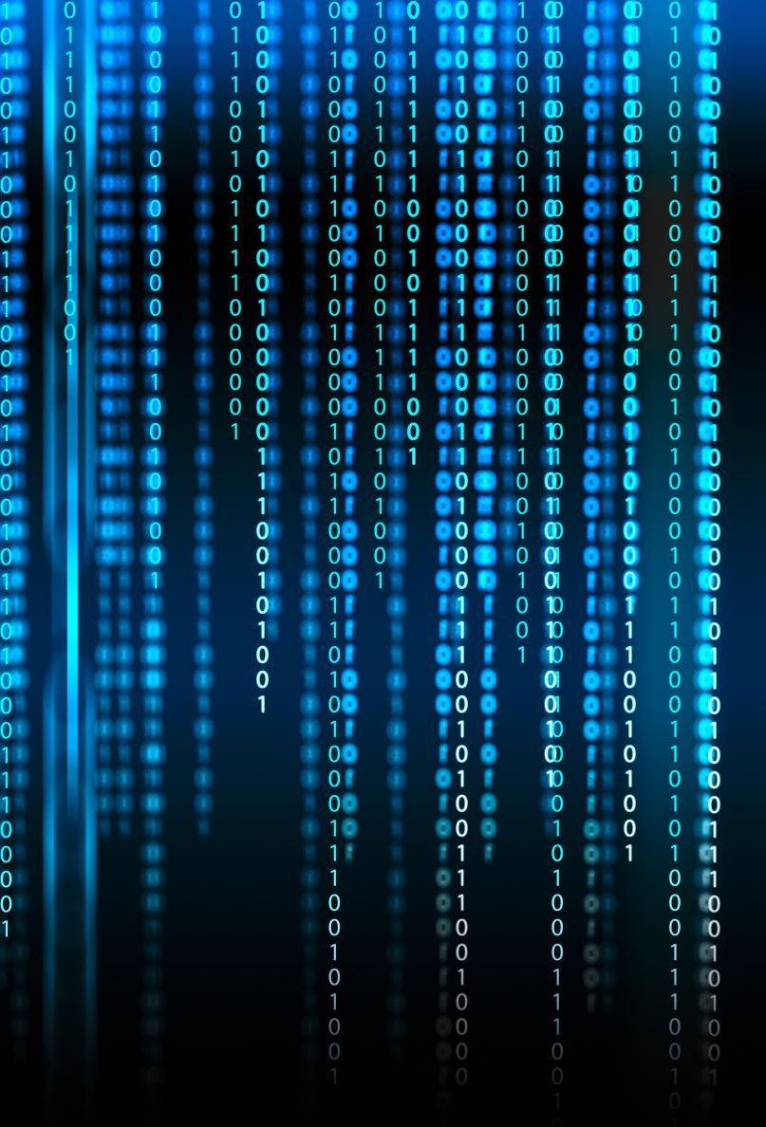
Algorithms & application
Quantum computing can be applied in various domains
Shor's Algorithm- a quantum algorithm for factoring large numbers efficiently. It has significant implications for cryptography since many modern cryptographic systems rely on the difficulty of factoring large numbers.
Notes:
Quantum computing can be applied in various domains such as cryptography where quantum computers can break many encryption methods, use simulations that accurately model quantum systems at a molecular level, and machine learning which can enhance pattern recognition along with data analysis capabilities. In terms of quantum computing algorithms, many areas are actively being researched and explored in various fields.
Shor's algorithm- a quantum algorithm for factoring large numbers efficiently. If large-scale quantum computers become practical, Shor's algorithm could potentially break these cryptographic systems.
The algorithm is composed of two parts. The first part of the algorithm turns the factoring problem into the problem of finding the period of a function, and is responsible for the quantum speedup.

Slide 25
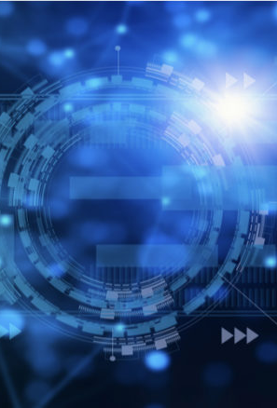
Cont.
Grover's algorithm- Grover's algorithm is a quantum search algorithm that can provide a quadratic speedup compared to classical search algorithms. Grover's algorithm has applications in database searching, optimization, and combinatorial problems.
Notes:
Grover's algorithm- Grover's algorithm is a quantum search algorithm that can provide a quadratic speedup compared to classical search algorithms. To break it down, let’s say we’re given a large list of N items and Among these items is one item with a unique property that we wish to locate. We can call this item the A. all items in the list are gray except the A, which is red. Using classical computing, we would have to find all of the item's value whereas Grover’s algorithm allows us to find it in just half the amount of steps.

Slide 26
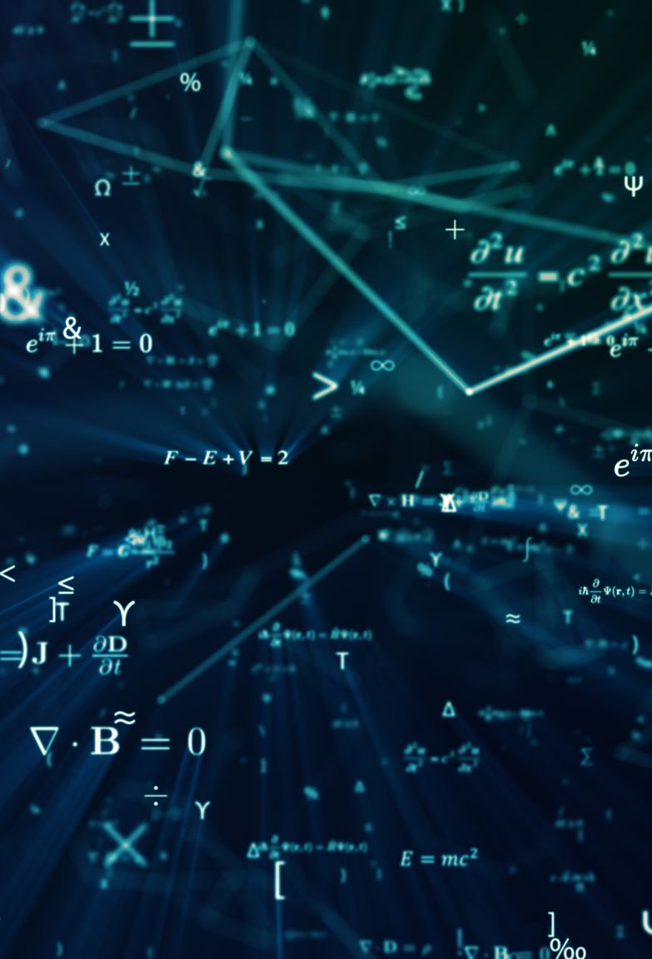
Quantum advantages
Exponential Speedup: Quantum computers can solve certain problems exponentially faster than classical computers. This speedup is most significant for problems that involve searching, optimization, and factoring large numbers.
Notes:
The concept of quantum advantage is where quantum computers outperform classical computers.
Some advantages of quantum computing include Exponential Speedup, quantum parallelism, cryptographic impact, and simulation.

Slide 27
Quantum advantages
Quantum Parallelism: Quantum computers can process multiple possibilities at the same time due to the property of superposition, allowing them to explore different solutions at once.

Slide 28
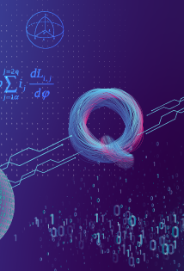
Cont.
Cryptographic Impact: Quantum computing has the potential to break many currently used cryptographic protocols, leading to the development of quantum-resistant cryptography.
Simulation of Quantum Systems: Quantum computers can simulate quantum systems accurately, which is crucial for studying complex molecules and materials, benefiting fields like drug discovery and material science.

Slide 29
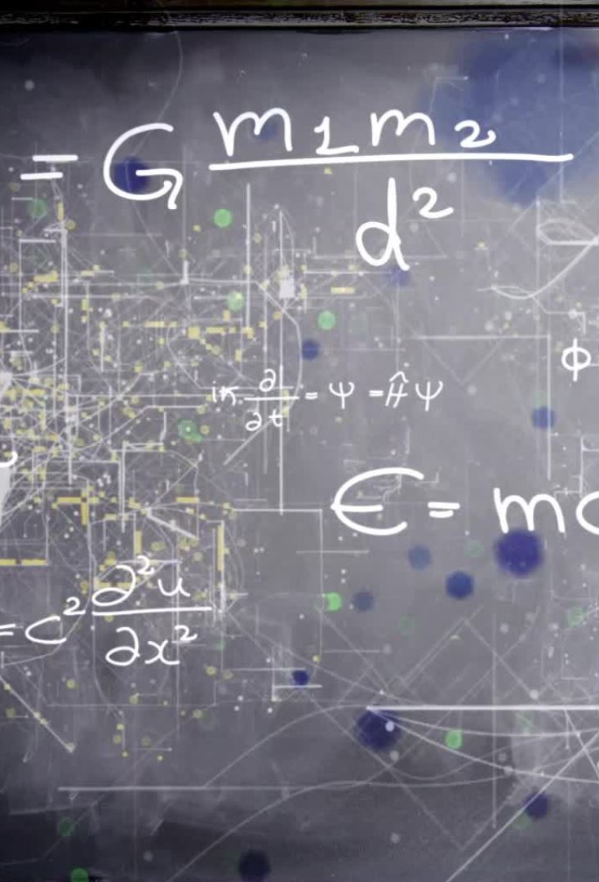
QUantum limitations
Noisy Intermediate-Scale Quantum (NISQ) Devices: Current quantum computers have a limited number of qubits and high error rates. They are not yet capable of outperforming classical computers for most practical tasks.
Decoherence and Errors: Quantum computers are prone to environmental sensitivity leading to qubit fragility
Notes:
This causes decoherence, which can lead to errors in computations. To minimize error, correction techniques are essential but are complex and require additional qubit adjustments.

Slide 30
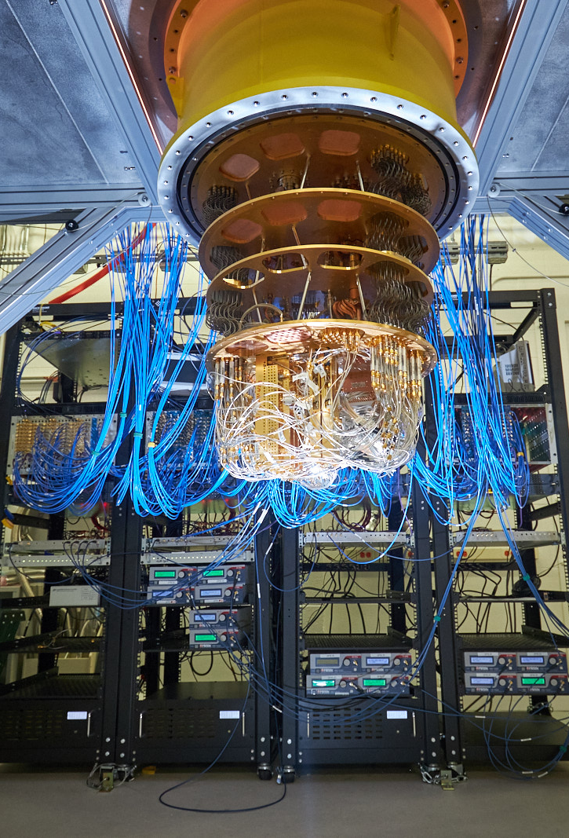
Quantum Computing Hardware
Trapped Ions: Ions held in electromagnetic traps are used as qubits. They have excellent coherence properties and have been demonstrated in various experiments
Notes:
The hardware component includes quantum processors which is the main component that makes the quantum computer run. There are different flavors of quantum processors such as photonic, qubits, ion trap, and others. Most recently, ion trap quantum processors have been shown to provide greater isolation for qubits

Slide 31
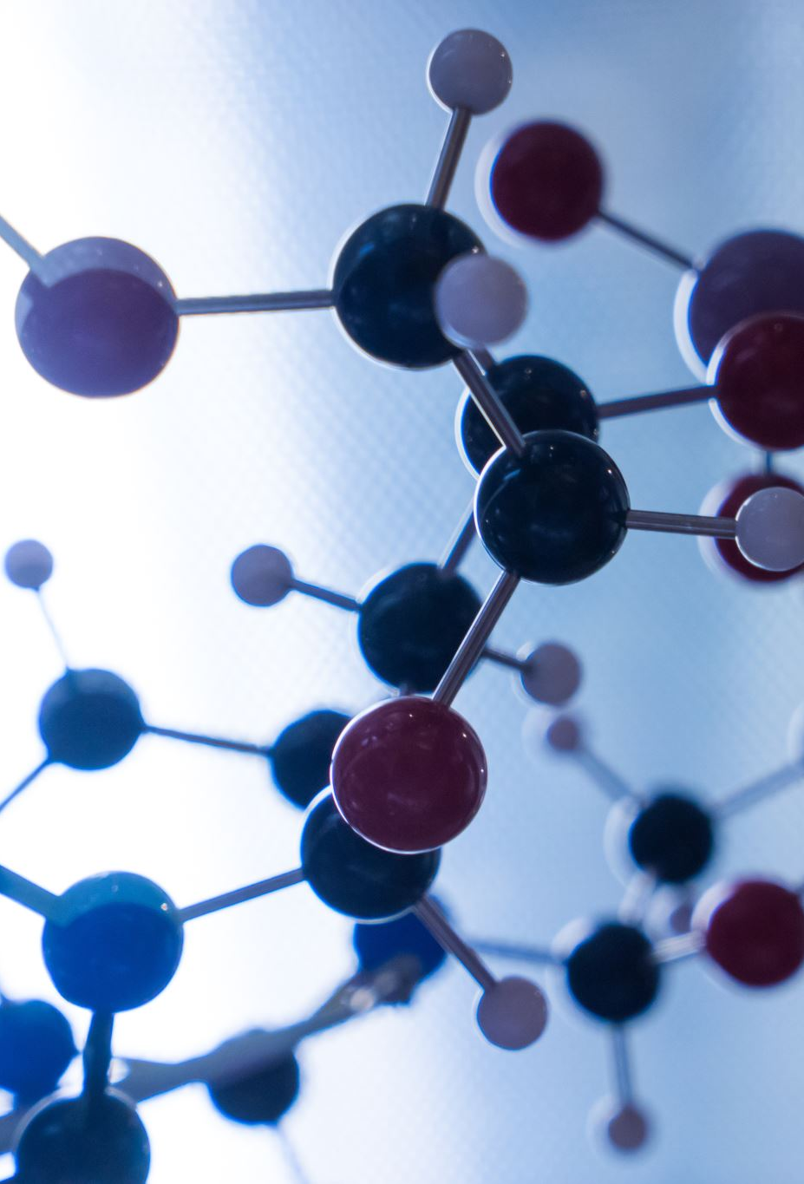
Quantum Computing Hardware
Photonic Qubits: Photons are used as qubits in quantum optics-based quantum computing. They offer the advantage of low susceptibility to decoherence but face challenges in controlled interactions.

Slide 32
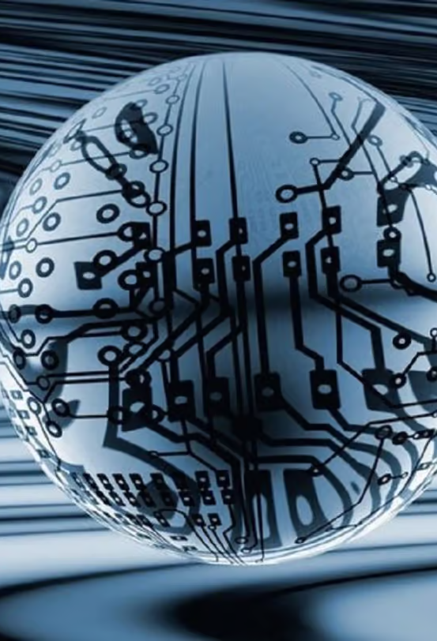
Cont.
Superconducting Qubits: One of the most promising qubit implementations, these use superconducting circuits to create and manipulate qubits. They are the basis for many quantum processors by companies like IBM and Google.

Slide 33

Leading companies in quantum computing

Slide 34
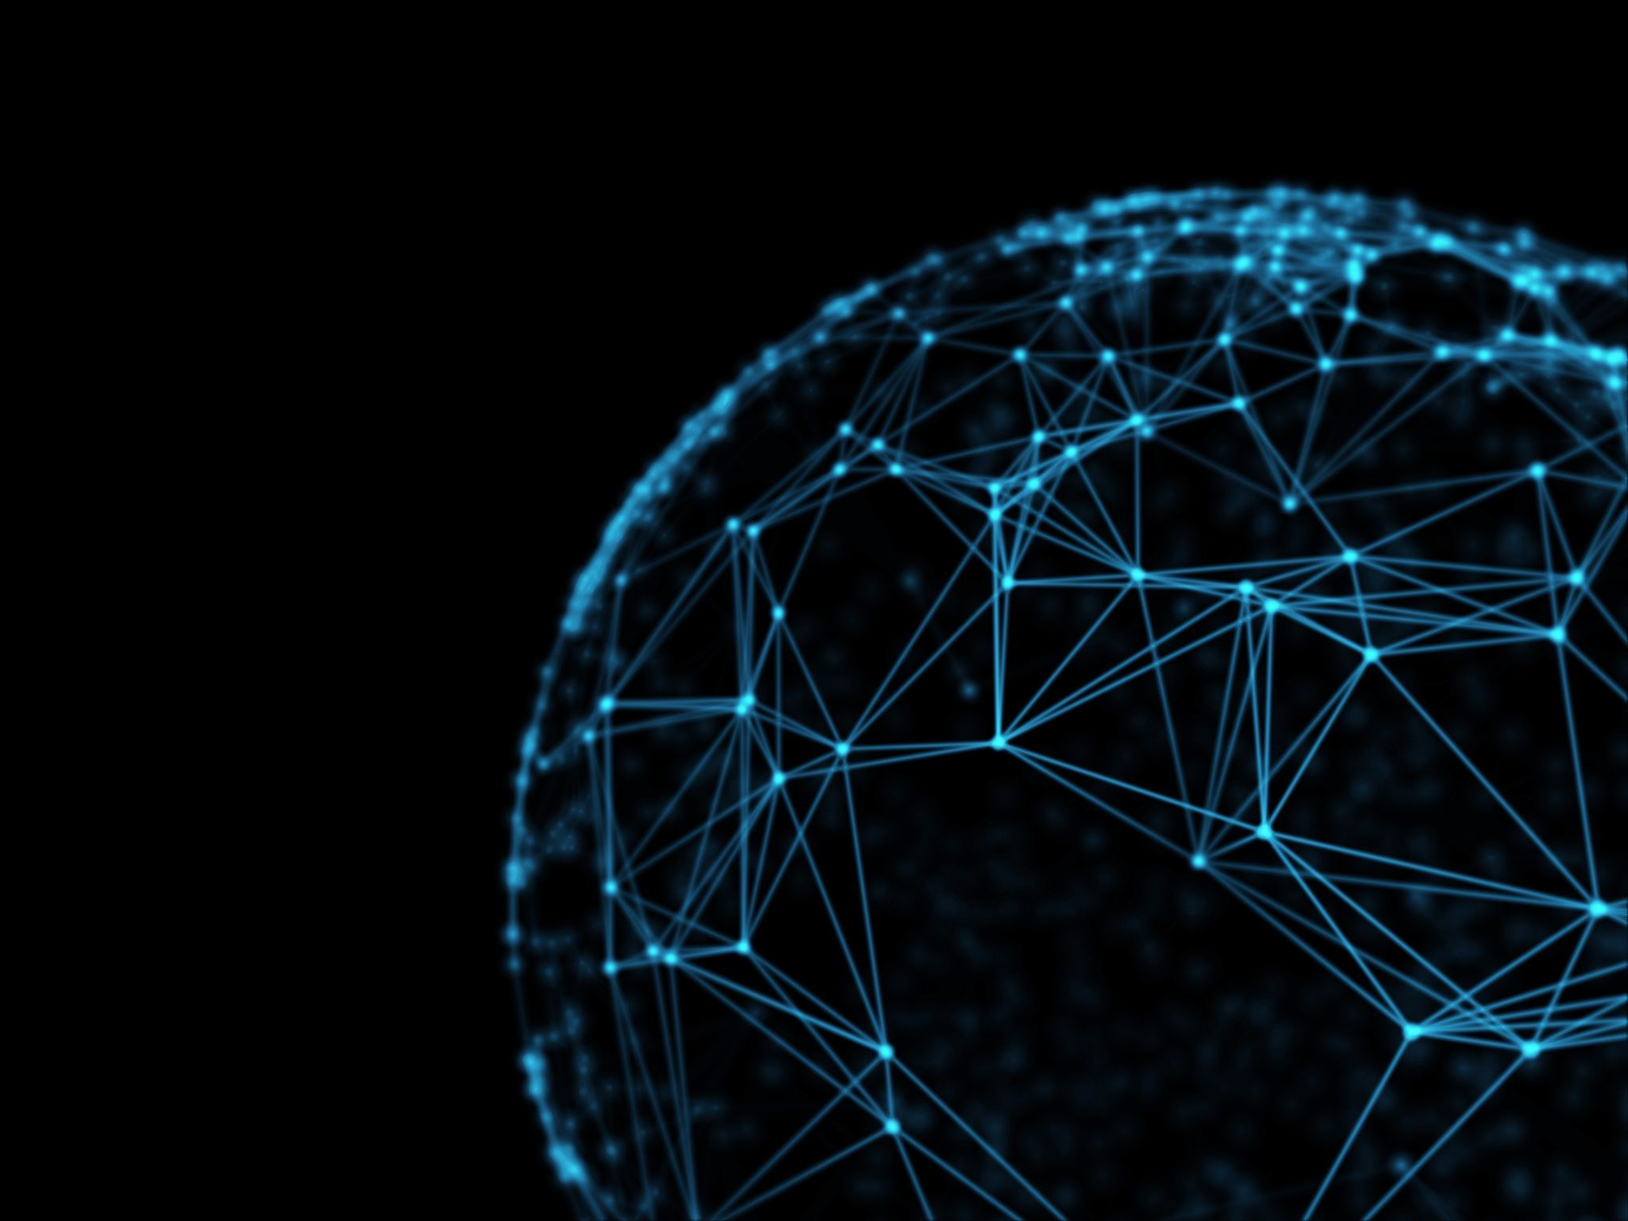
Google
Google's journey into quantum computing began in earnest in 2009 when it, along with NASA and the Universities Space Research Association, launched the Quantum Artificial Intelligence Lab. This initiative used quantum computers developed by D-Wave Systems, a Canadian quantum computing company, to explore the potential of quantum algorithms in machine learning.
However, the real landmark in Google's quantum computing journey came with the 2014 launch of its Quantum AI team, aimed at building its own quantum hardware and software. The team was led by John Martinis, a renowned physicist who had been studying quantum computing since the 1980s. Under his leadership, Google focused on developing error-corrected quantum computers.
In 2015, the team announced it had successfully created a nine-qubit linear array and started to use error detection techniques. This was a crucial step towards building scalable, reliable quantum computers.

Slide 35
Google in quantum computing
In 2019, Google reached a significant milestone by achieving what they termed "quantum supremacy". Using a 54-qubit processor named "Sycamore," Google's Quantum AI team reported that they performed a calculation in 200 seconds that would have taken a classical supercomputer approximately 10,000 years. This marked the first time a quantum computer performed a task beyond the reach of traditional computers, solidifying Google's position as a leading player in the field.
While Google's Quantum AI team continues its efforts to improve error correction and develop scalable quantum computers, the company is also fostering a broader quantum ecosystem. They launched Cirq, an open-source project that allows developers to create and manipulate quantum circuits, and TensorFlow Quantum, an open-source library for the rapid prototyping of quantum ML models.

Slide 36
IBM
IBM's journey into quantum computing began in the early 2000s, with foundational research conducted in their labs. But it was in 2016 that IBM made a notable stride, becoming one of the first companies to offer the public access to a quantum computer. This pioneering initiative, known as the IBM Quantum Experience, provided researchers and the general public with an online platform to run experiments on a five-qubit quantum computer.
Building on this, in 2017, IBM launched IBM Q, a commercial quantum computing program. This milestone marked a commitment to making quantum computers commercially available. IBM Q allowed businesses and researchers to explore practical applications for quantum computing and to advance their own quantum-related strategies.
In the same year, IBM also introduced two new processors: a 16-qubit processor for the IBM Quantum Experience and a 17-qubit prototype commercial processor. The introduction of these processors was a significant leap toward constructing a universal quantum computer.

Slide 37
Ibm in quantum computing
In 2019, IBM made another leap forward with the unveiling of the IBM Q System One, which it described as the world's first integrated universal approximate quantum computing system designed for scientific and commercial use. Enclosed in a nine-foot-tall, airtight glass cube, the IBM Q System One was designed to maintain the quality of qubits, which are highly sensitive to environmental interference.
IBM also played a critical role in the development of the Quantum Computing Software Project Qiskit, an open-source quantum computing software development framework. Qiskit provides tools for creating and manipulating quantum programs and running them on prototype quantum devices and simulators.
IBM has continued to innovate and make strides in the field of quantum computing. The company has set its sights on achieving Quantum Advantage, the point where certain information processing tasks can be performed more efficiently or cost-effectively on a quantum computer, versus a classical one. Their focus lies in creating a viable, large-scale quantum computer and expanding the accessibility of quantum computing through the IBM Quantum Network. This network comprises Fortune 500 companies, academic institutions, startups, and national research labs, all of whom are working with IBM to advance the field of quantum computing.

Slide 38
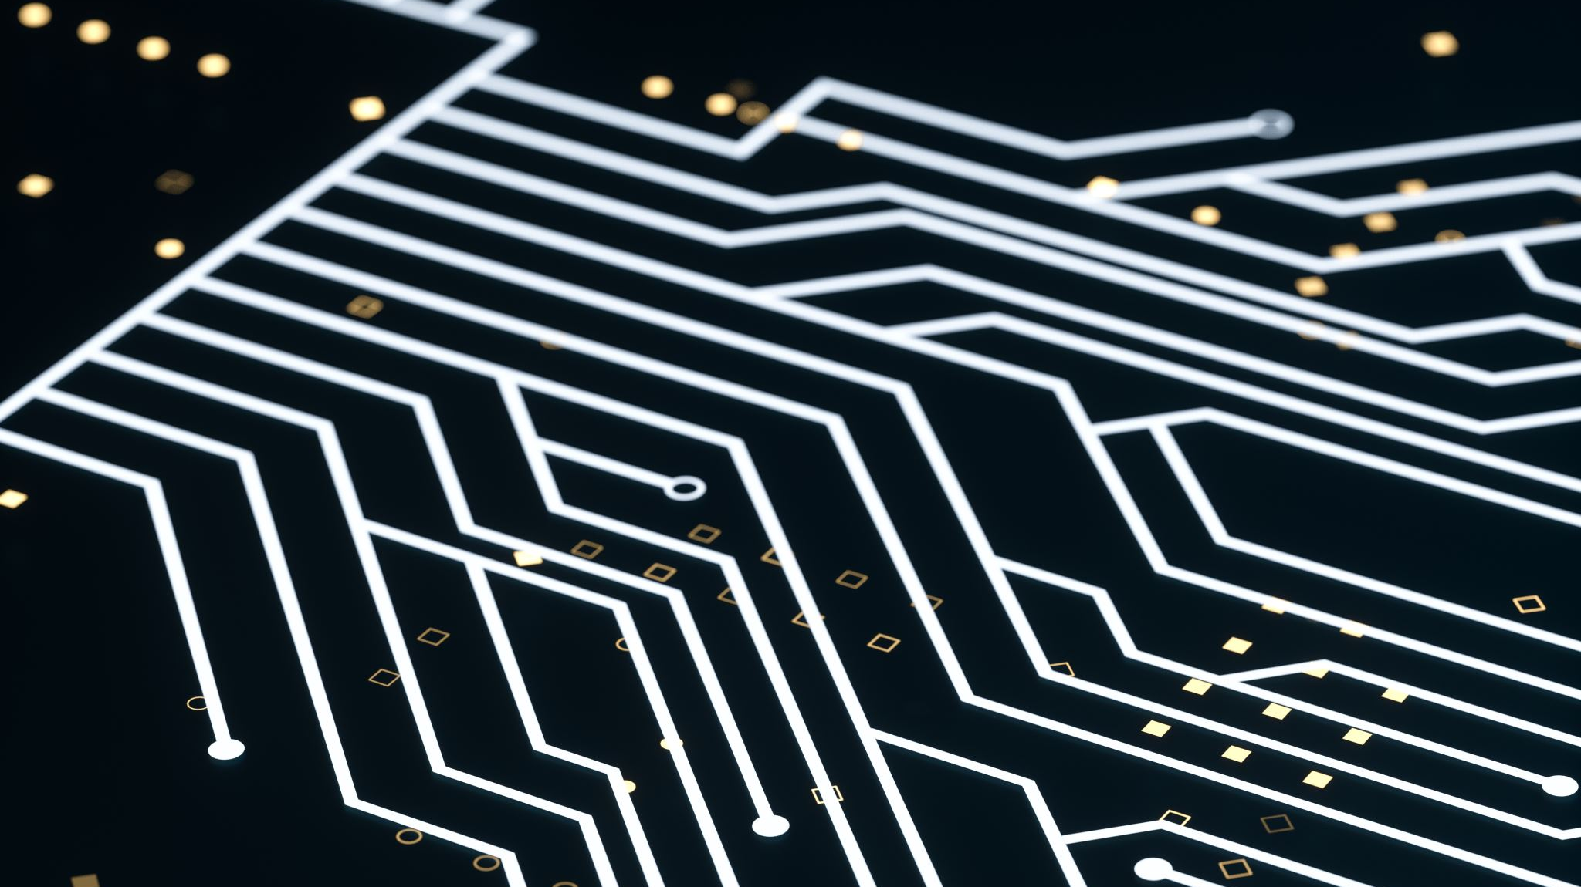
Microsoft
Microsoft's engagement with quantum computing has its roots in the early 2000s, under the leadership of Michael Freedman, a renowned mathematician and Fields Medal recipient. Freedman was brought onboard Microsoft to start the Station Q research lab, which was to become the basis of Microsoft's quantum efforts.
Over the years, Microsoft has differentiated its approach to quantum computing by focusing on a theoretical model known as topological quantum computing. In this model, the quantum bits (qubits) are represented by quasi-particles known as anyons. This topological approach could, theoretically, offer more stable qubits, reducing the issue of error-correction that plagues other types of quantum systems.
In 2017, Microsoft took a significant step by establishing Microsoft Quantum, its dedicated quantum computing division. In the same year, the company introduced Q#, a new programming language designed for quantum computing, and the Quantum Development Kit. Q# enables developers to write quantum algorithms and it's integrated with Visual Studio, a popular integrated development environment.

Slide 39
Microsoft in quantum computing
Microsoft also announced its intention to build a scalable quantum computer by leveraging topological qubits. As a part of this effort, Microsoft assembled an all-star team of quantum physicists, mathematicians, and computer scientists, including prominent figures such as Leo Kouwenhoven and Charles Marcus.
In the ensuing years, Microsoft expanded its quantum efforts by partnering with universities and research institutions around the world. Known as the Microsoft Quantum Network, this collaborative initiative was designed to share knowledge, drive quantum research, and develop a skilled workforce for the quantum economy.
Although Microsoft had not announced a working quantum computer, the company has been significantly contributing to the quantum computing landscape through the development of quantum algorithms, quantum software, and workforce training initiatives. Microsoft's approach aims to solve the daunting technical challenges of quantum computing and develop a scalable, error-corrected quantum computer.

Slide 40
Amazon
Amazon's entry into the field of quantum computing took a unique approach, with a focus on providing quantum computing resources as a cloud service rather than creating its own quantum hardware. The company entered the quantum computing landscape in 2020 through Amazon Web Services (AWS), its cloud computing subsidiary.
Amazon's first notable foray into quantum computing was the launch of Amazon Braket in 2020. Named after the Bra-ket notation commonly used in quantum mechanics, Braket is a fully managed service that allows scientists, researchers, and developers to experiment with computers from various quantum hardware providers. As of my knowledge cutoff in September 2021, Amazon Braket allowed users to access quantum computing hardware from D-Wave, IonQ, and Rigetti.

Slide 41
Amazon in quantum computing
Amazon's approach with Braket is to allow users to design their quantum algorithms using the service and then choose to run those algorithms either on a classical simulator or a real quantum computer. This provides users with a platform to explore and understand quantum computing, build and test their quantum algorithms, and even perform their computational tasks on actual quantum hardware.
In addition to Braket, Amazon has also launched the AWS Center for Quantum Computing and the AWS Quantum Solutions Lab. The Center for Quantum Computing is a research center dedicated to advancing quantum computing technologies, while the Quantum Solutions Lab focuses on helping AWS customers leverage quantum technology and develop their own quantum algorithms and applications.
As of my knowledge cutoff in September 2021, Amazon had not announced the development of its own quantum hardware. However, through Braket, the Center for Quantum Computing, and the Quantum Solutions Lab, Amazon continues to establish itself as a major player in the field by providing a wide range of resources for quantum computing research and development.

Slide 42
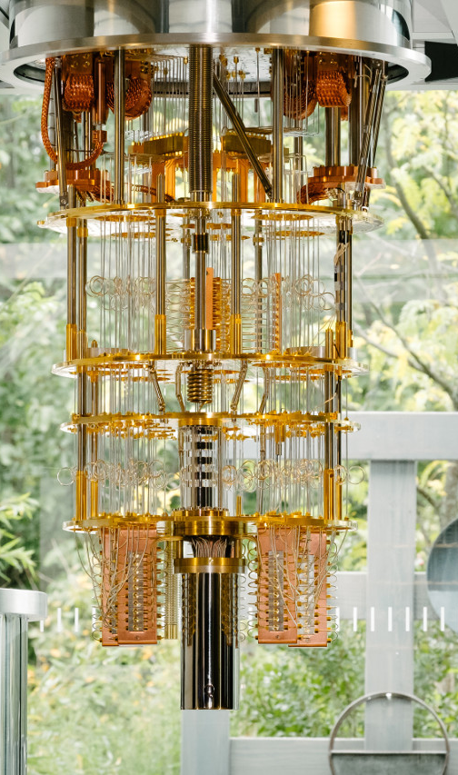
What are the technology issues that need to be resolved?
Qubit Stability: Quantum bits, or qubits, which are the basic unit of quantum information, are highly sensitive to environmental noise. This sensitivity leads to a high error rate and limits the time during which computations can be performed, a period known as quantum coherence.
Error Correction: Given the high error rate in qubit operations, robust quantum error correction techniques are crucial for building practical quantum computers. However, implementing these techniques is challenging and usually requires a large number of physical qubits to encode a single, logical (error-corrected) qubit.
Qubit Scalability: Building a quantum computer with a large number of qubits is a significant challenge due to issues with qubit stability and error correction. As of my knowledge cutoff in September 2021, quantum computers with 100 qubits were considered large, while practical applications will likely require machines with thousands or even millions of qubits.
This Photo by Unknown author is licensed under CC BY-SA-NC.

Slide 43
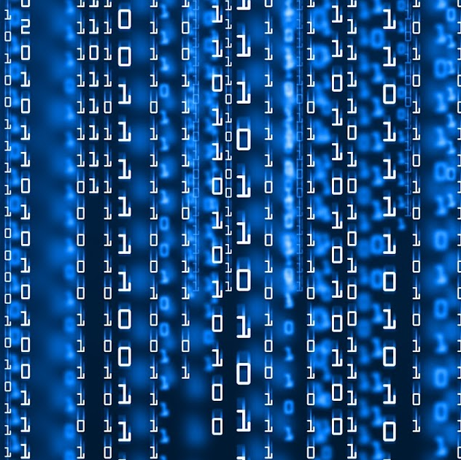
What are the technology issues that need to be resolveded?
Quantum Software and Algorithms: As quantum computers are fundamentally different from classical computers, new algorithms and software must be developed to exploit their capabilities. Many quantum algorithms have been proposed, but they often require error-corrected, large-scale quantum computers to show a quantum advantage.
Quantum Networking and Communication: In order to build a 'quantum internet', quantum computers must be able to send and receive quantum information via quantum networks. However, transmitting quantum information over long distances without it being disturbed is a significant challenge.
Hardware Variety: There are multiple approaches to building physical qubits (superconducting circuits, trapped ions, topological qubits, etc.), and it's still an open question which (if any) will be most successful in the long term. Each has its strengths and weaknesses and pose unique engineering challenges.
This Photo by Unknown author is licensed under CC BY-SA-NC.

Slide 44
References
Ladd, T. D., Jelezko, F., Laflamme, R., Nakamura, Y., Monroe, C., & O’Brien, J. L. (2010). "Quantum computers." Nature, 464(7285), 45-53.
Preskill, J. (2018). "Quantum Computing in the NISQ era and beyond." Quantum, 2, 79.
IBM Quantum Experience - https://quantum-computing.ibm.com/
"A fast quantum mechanical algorithm for database search" by Lov Grover, Proceedings of the Twenty-Eighth Annual ACM Symposium on the Theory of Computing, 1996
5 Essential Hardware Components of a Quantum Computer | Quantum Computing: Progress and Prospects | The National Academies Press
https://en.wikipedia.org/wiki/Quantum_computing
https://www.edn.com/the-basics-of-quantum-computing-a-tutorial/
https://www.investopedia.com/terms/q/quantum-computing.asp
https://news.uchicago.edu/story/noise-cancelling-qubits-can-minimize-errors-quantum-computers
https://www.bloomberg.com/news/articles/2019-09-12/ibm-launches-new-mainframe-generation-to-combat-cybercrime
https://quantum-computing.ibm.com/composer/docs/iqx/guide/grovers-algorithm
https://scienceexchange.caltech.edu/topics/quantum-science-explained/quantum-computing-computers
https://auth0.com/blog/what-do-quantum-computers-mean-for-security/

Slide 45
References
"Amazon Brings Quantum Computing to AWS Cloud with Braket" - TechCrunch, 2019. Link
"AWS Center for Quantum Computing" - Amazon Web Services, n.d. Link
"Amazon's Quantum Computing Service, Braket, Launches Today" - ZDNet, 2020. Link
"Amazon Web Services Opens up its Quantum Computing Service, Braket, to the Public" - GeekWire, 2020. Link
"Google Launches Quantum Computing Lab" - Nature, 2013. Link
"Google AI Blog: Announcing Quantum Supremacy" - Google AI Blog, 2019. Link
"Google's Quantum Computing Breakthrough Brings Blockchain Resistance Into the Spotlight Again" - Forbes, 2019. Link
"Google’s Quantum Computer Achieves Breakthrough" - The New York Times, 2019. Link
"Google's Quantum Bet on the Future of AI—and What It Means for Humanity" - Forbes, 2020. Link

Slide 46
References
"Microsoft's quantum computing network takes one giant leap at Startup Summit" - Microsoft News Center, 2019. Link
"Microsoft doubles down on quantum computing bet" - ZDNet, 2018. Link
"Microsoft makes play for next wave of computing with quantum computing toolkit" - The Seattle Times, 2017. Link
"Microsoft quantum computing: How a new Microsoft Cloud service and coding language will prepare us for the quantum computing revolution" - Microsoft Innovation Stories, 2017. Link
"Microsoft's Quantum Mechanics" - The New Yorker, 2014. Link
"IBM's Quantum Experience" - IBM Research Blog, 2016. Link
"IBM Raises the Bar with a 50-Qubit Quantum Computer" - MIT Technology Review, 2017. Link
"IBM Q System One: IBM's Quantum Computing System for Commercial Use" - IBM News Room, 2019. Link
"IBM's Quantum Computing Roadmap" - IBM Research Blog, 2020. Link
"IBM's new 127-qubit processor is an important step toward the quantum computing future" - TechRepublic, 2021. Link

